Slide 1
Wine time

Slide 2
Background & Scope
Analysis of wine reviews to provide metrics for different wine making regions and varietals around the world
Trying to understand how the characteristics of different varietals are influenced by where they are grown and what impact that has on quality and pricing.
Could matter to wine retailers, wine makers, or just people interested in wine (e.g. me ☺)
It will be a classification model

Slide 3
Data
There is a dataset available on Kaggle with 130k wine reviews from Wine Enthusiast magazine which includes
Varietal
Vineyard
Region
Price
Review
Score
The data is a mix of continuous and discrete data points
Each observation is one vintage of one wine across multiple wines from multiple wineries around the world
Intend to build a data scraper to data from other sources as well

Slide 4
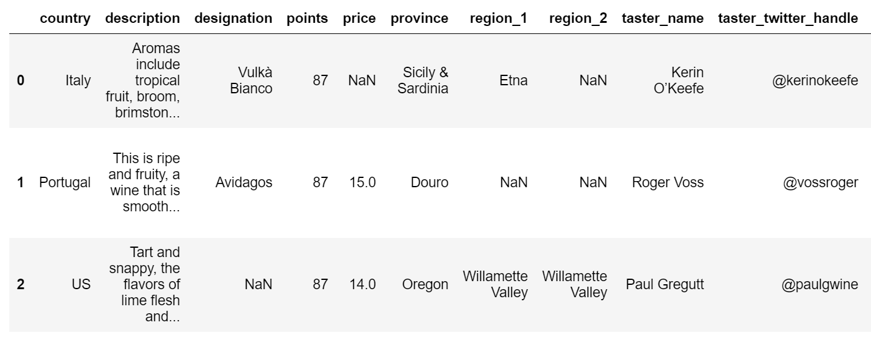
Data

Slide 5
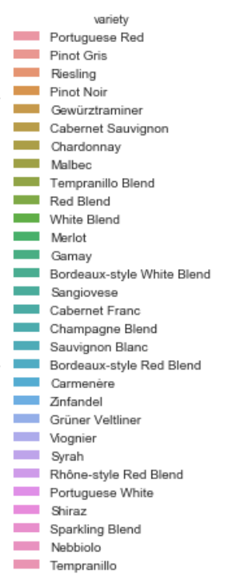
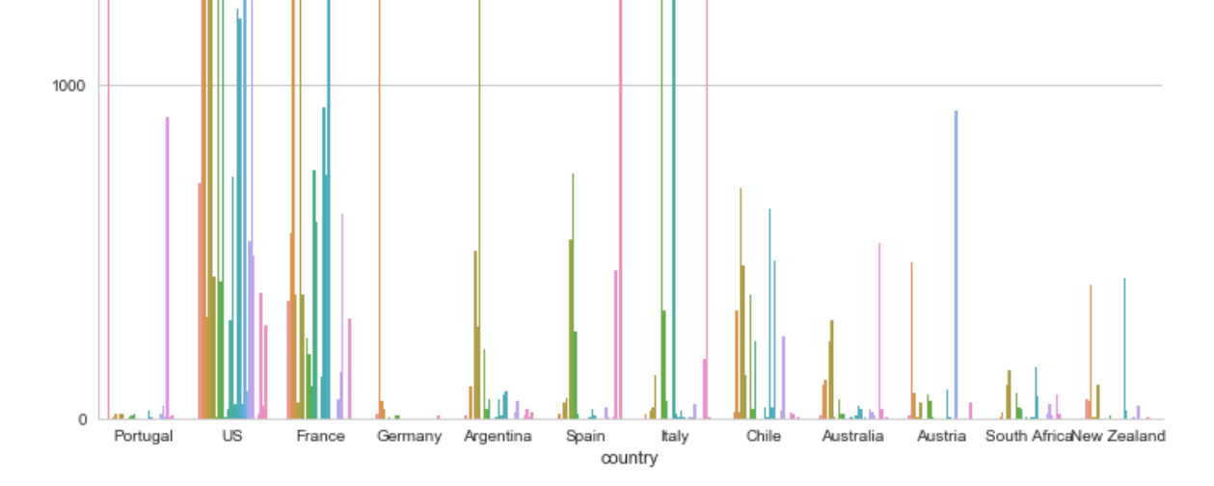
Cleaned data

Slide 6
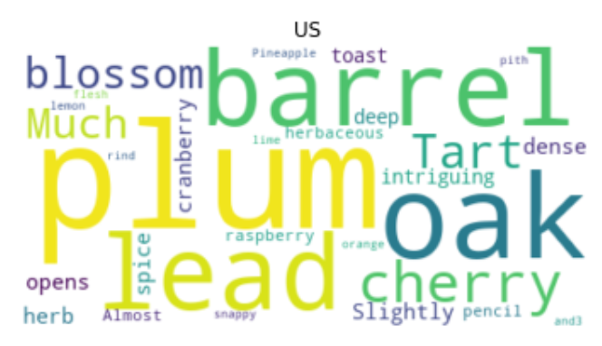
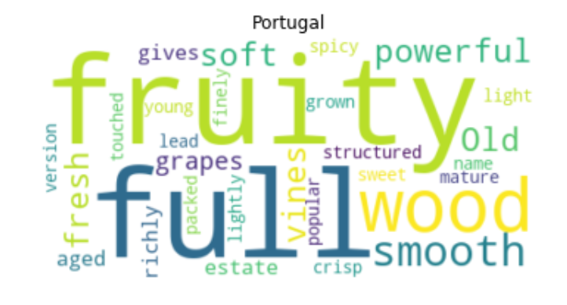
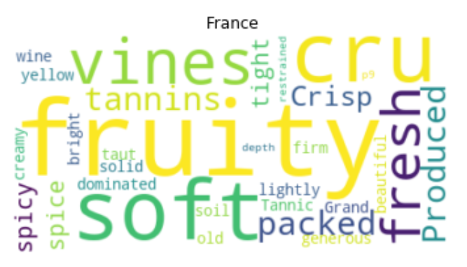
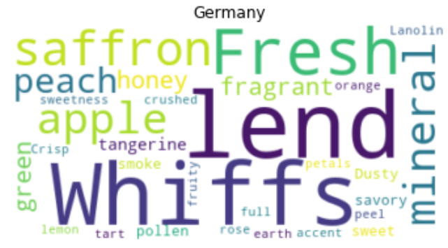
Word clouds - country

Slide 7
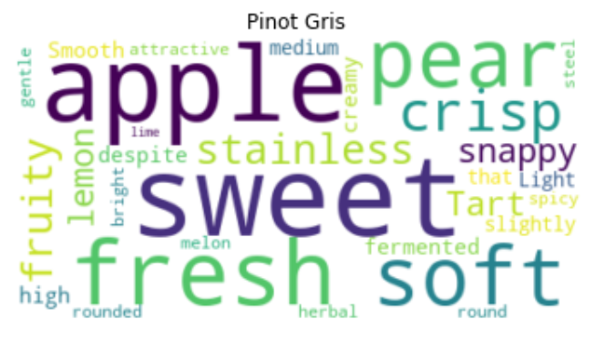
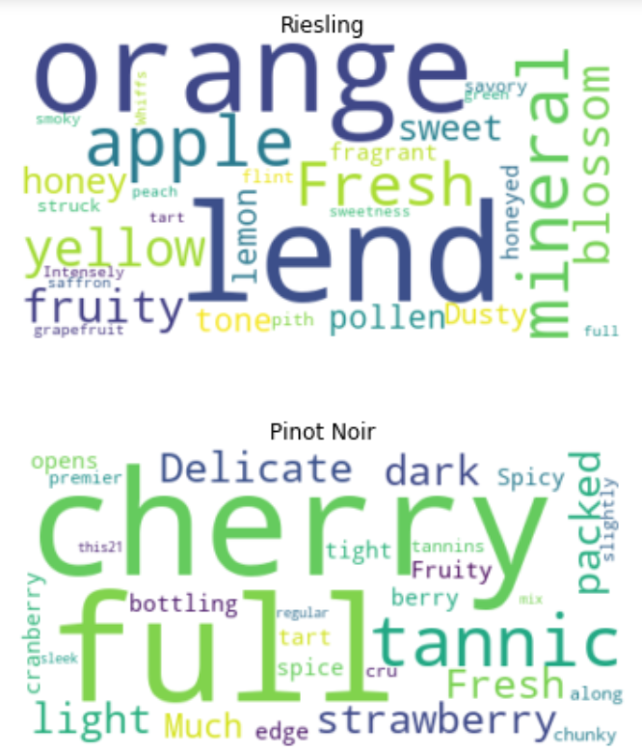
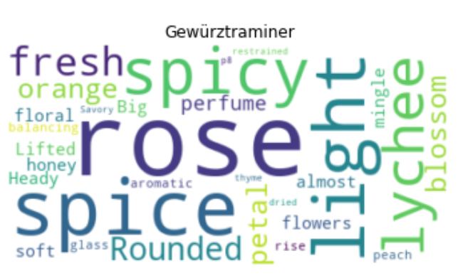
Word cloud - variety

Slide 8
Important words – document frequencies
Chardonnay | Sangiovese | Syrah | Viognier | Pinot Noir
Lemon | Espresso | purple | bubblegum | cola
Chablis | Tilled | boysenberry | viscous | rhubar
Pear | Skinned | smoked | peach | pomegranate
Butter | Brunello | meat | honeysuckle | cranberry
Apple | Underbrush | syrahs | apricot | strawberry
Lemon Curd | Evident alcohol | green olive | fermented aged | forest floor
Crème brulee | Black skinned | cracked pepper | stainless steel | wild strawberry
Baked apple | Skinned berry | black pepper | apricot peach | cherry cola
Sea salt | Blue flower | bacon fat | barrel fermented | rose petals
Apple pear | Wild cherry | smoked meat | barrel fermented | black tea

Slide 9
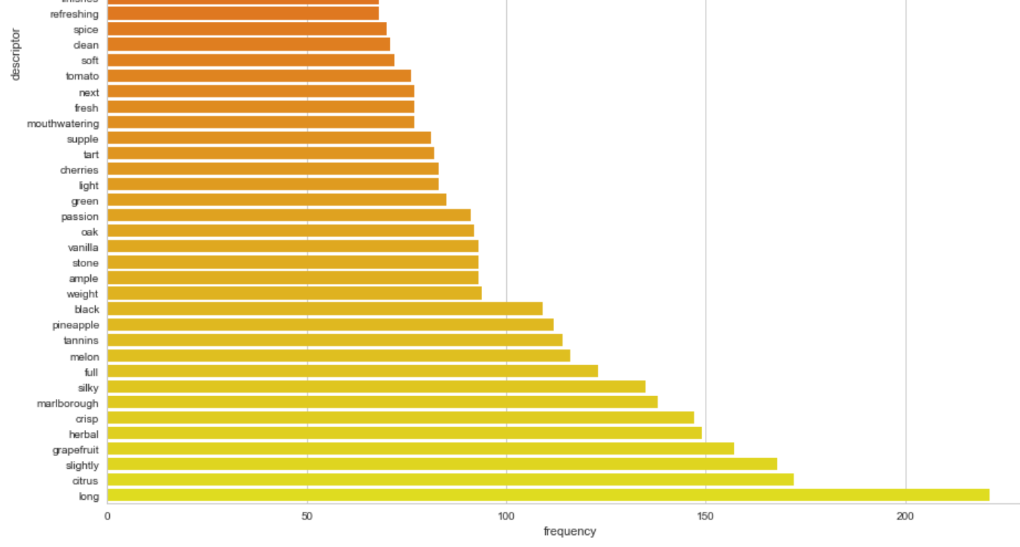
Test on NZ wines

Slide 10
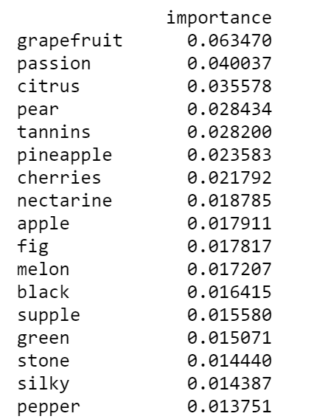
Test on NZ wines
BernoulliNB | SVM | Decision tree | Random Forest | Gradient boosting
0.75 | 0.88 | 0.70 | 0.83 | 0.73

Slide 11
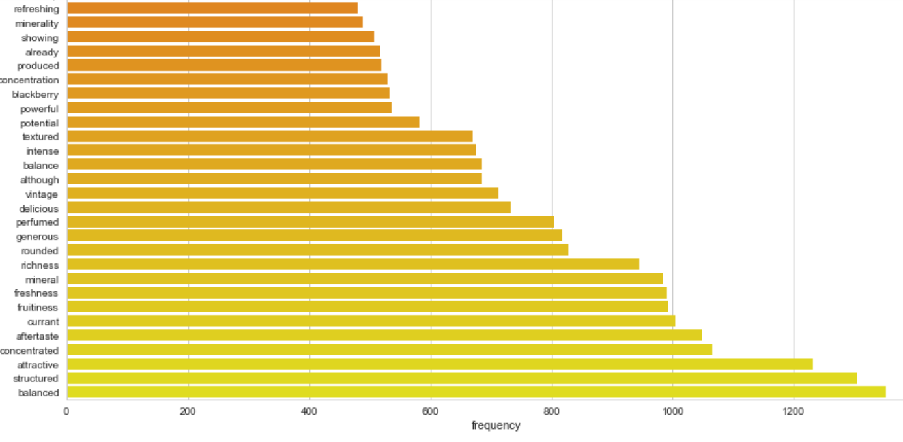
Test on French wines

Slide 12
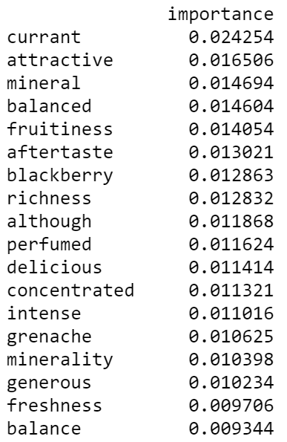
Test on French data
BernoulliNB | SVM | Decision tree | Random Forest | Gradient boosting
0.55 | 0.63 | 0.32 | 0.40 | 0.45

